Slide 1



Data Analysis Fundamentals Lecture 1: Career Overview - Data Scientist
Vikas Kumar
Indian Institute of Technology Bombay
04th September 2023

Slide 2
Outline
A brief history of Evolution of Data
Data - From a Decision Support System to Strategic Differentiator
The Data Maturity Hierarchy
Why choose Data Science as a career option?
Typical job roles in Data Science
The Data Science Pipeline
Toolkit of a Data Analyst
Your learning journey ahead!
Excel - Quickest way to start learning Data Analysis

Slide 3
Data
The Latin word data is the plural of datum meaning “given” or “to give”.
The first English use of the word "data" is from the 1640s.
The word "data" was first used to mean "transmissible and storable computer information" in 1946.
The expression "data processing" was first used in 1954.
The word data is synonymous with information.
Data is a collection of discrete or continuous values that convey information, describing the quantity, quality, fact, statistics, other basic units of meaning.

Slide 4
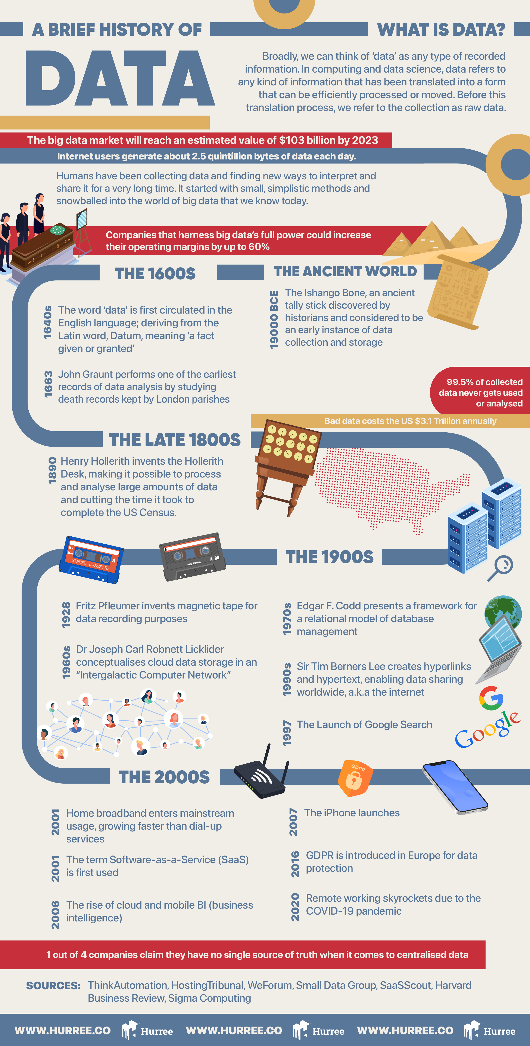
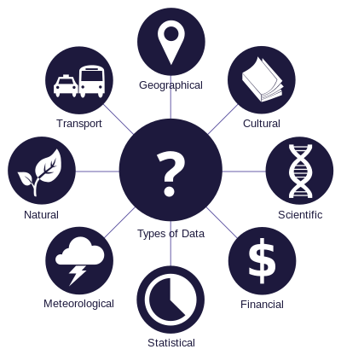
A brief history of Evolution of Data

Slide 5
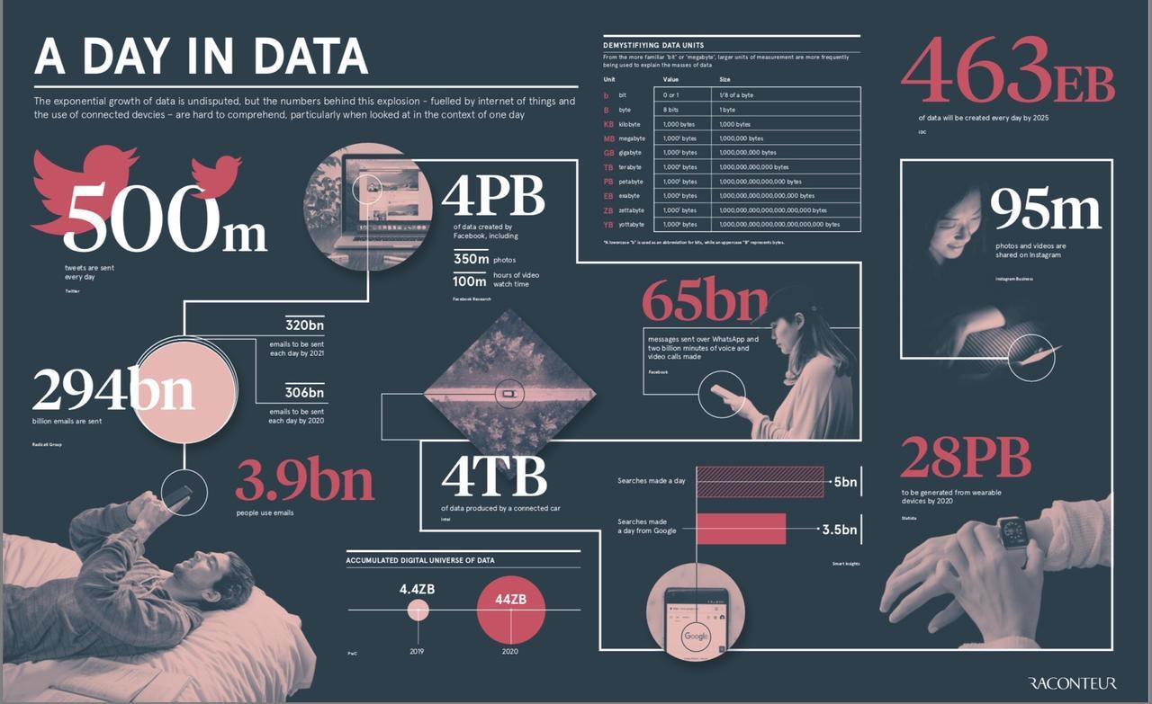
A Day in Data

Slide 6
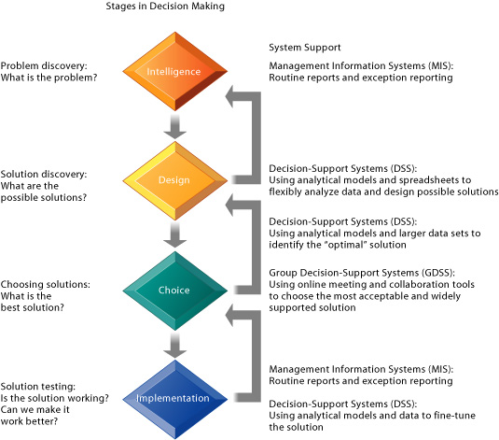
Data - From a Decision Support System to Strategic Differentiator

Slide 7
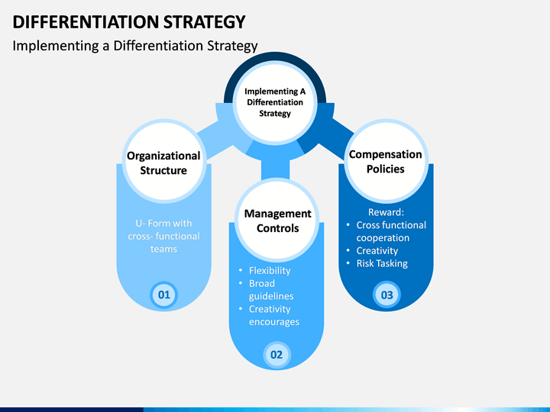
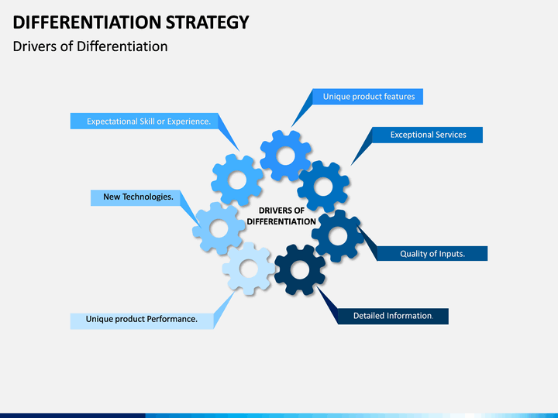
Data - From a Decision Support System to Strategic Differentiator

Slide 8
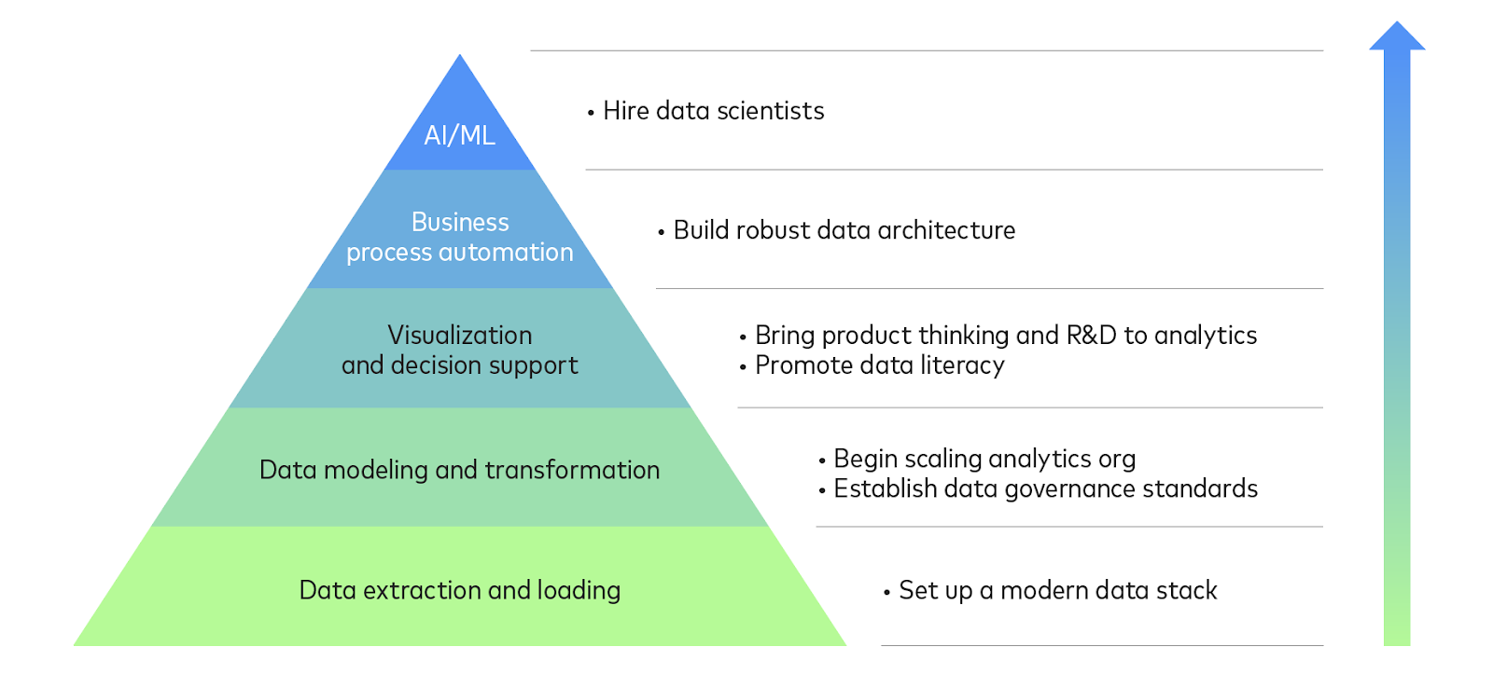
The Data Maturity Hierarchy

Slide 9
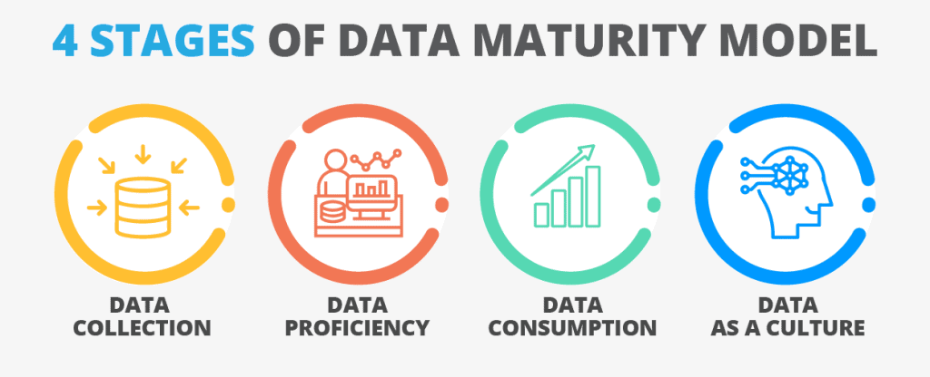
The Data Maturity Hierarchy

Slide 10

Data Science

Slide 11
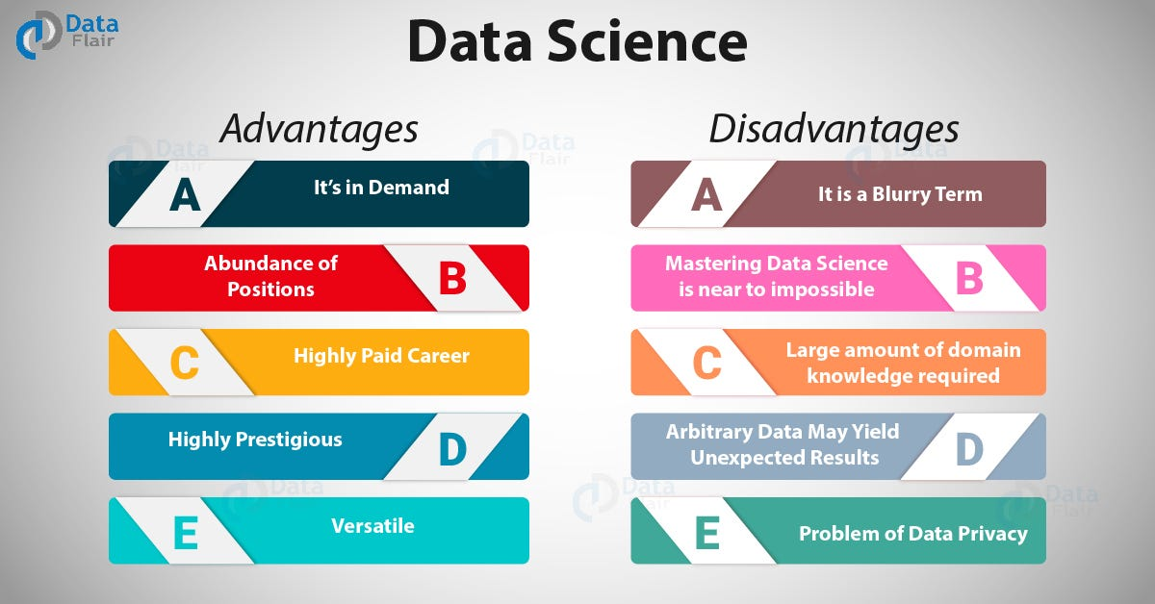
Why choose Data Science as a career option?

Slide 12
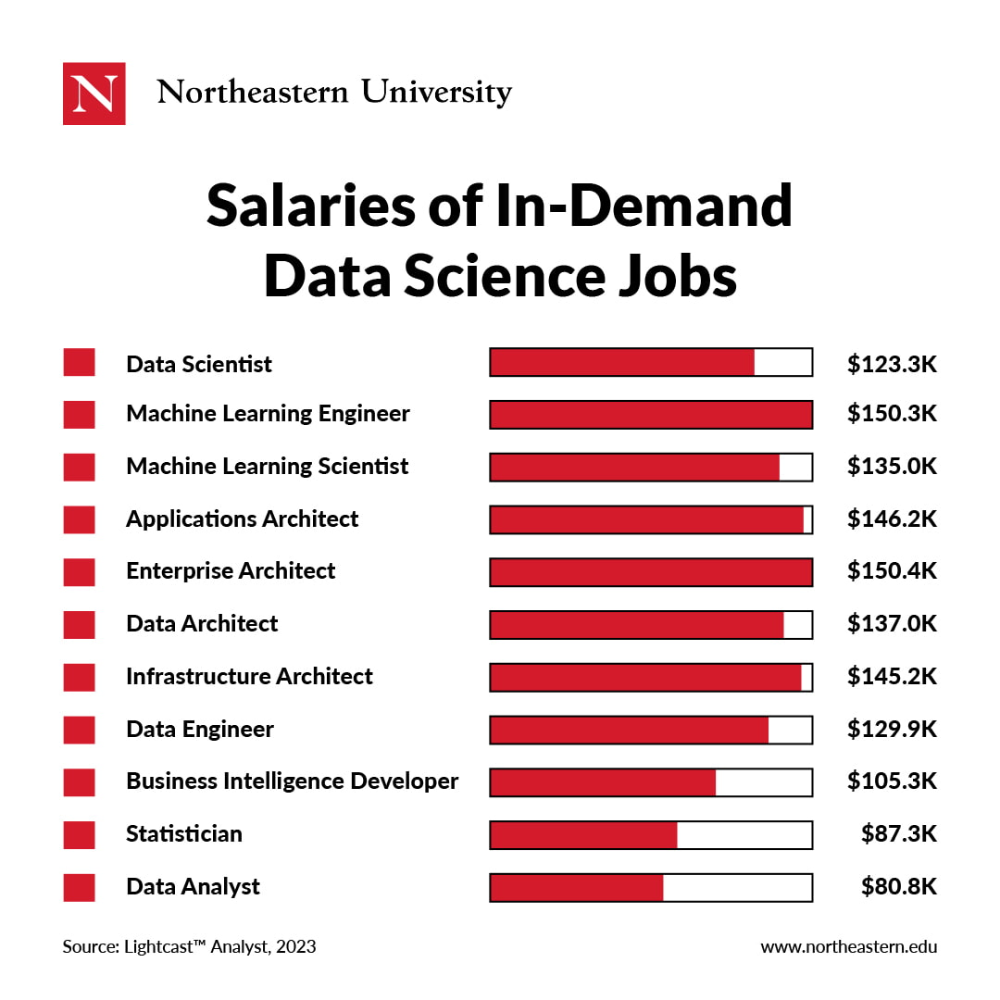
Typical job roles in Data Science

Slide 13
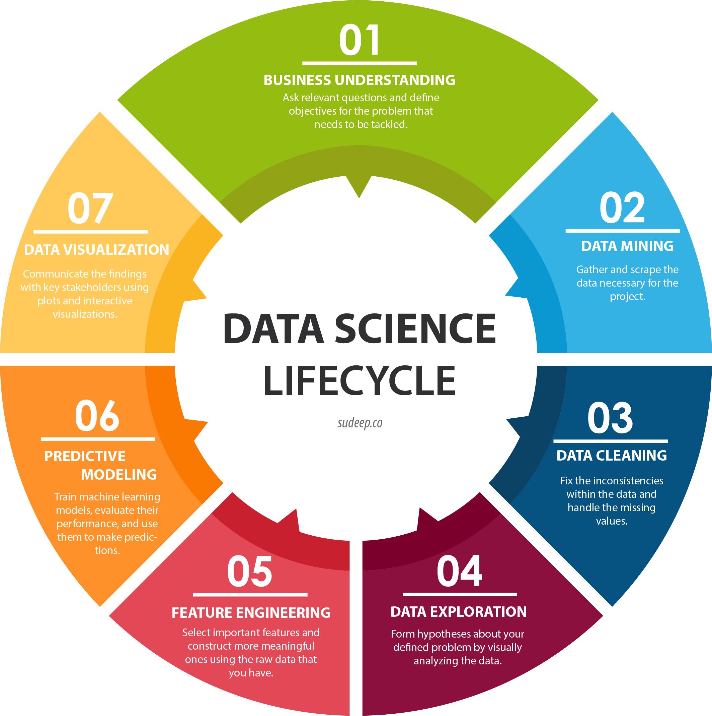
The Data Science Pipeline

Slide 14
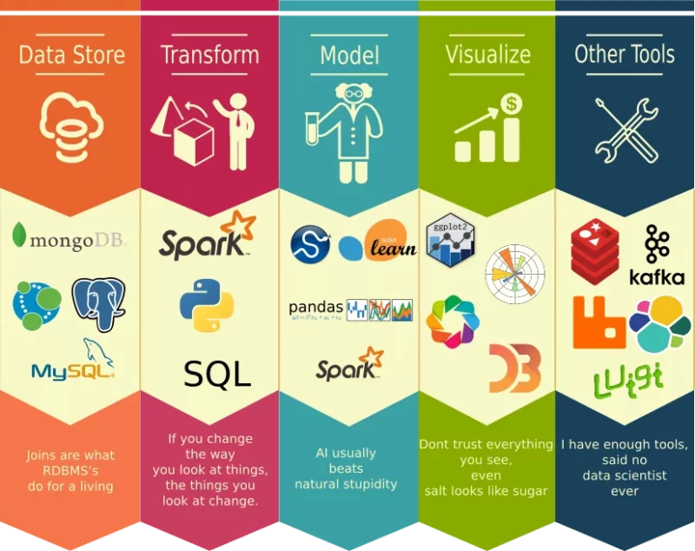
Toolkit of a Data Analyst

Slide 15
Your learning journey ahead!
Data
Data Operations
Data Modelling
Data Quality
Data Visualization
Excel
Power BI

Slide 16
Excel - Quickest way to start learning Data Analysis
Excel is a spreadsheet editor developed by Microsoft in 1985.
It features calculation or computation capabilities, graphing tools, pivot tables, and a macro programming language called Visual Basic for Applications (VBA).
Excel 2016 has 484 functions.
Microsoft classifies these functions into 14 categories.
Additional features are available using add-ins such as Analysis ToolPak, Solver Add-In.

Slide 17
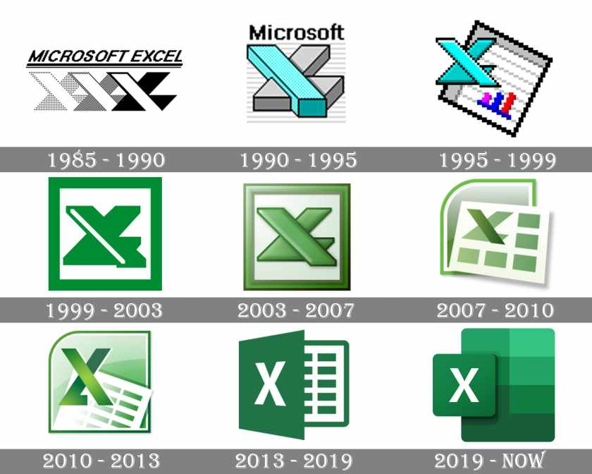
Excel - Quickest way to start learning Data Analysis

Slide 18


